Slide 1
Module 2 Hadoop Tools & YARN
Dr. S. Nandagopalan, Ph. D

Slide 2
Agenda
Essential Hadoop Tools
Hadoop YARN Applications
Managing Hadoop with Apache Ambari
Basic Hadoop Administration Procedures
Summary

Slide 3
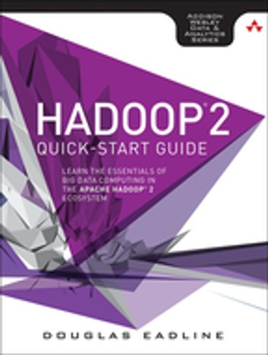
Text Book

Slide 4
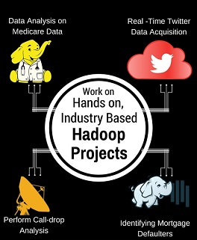
Hadoop Applications

Slide 5
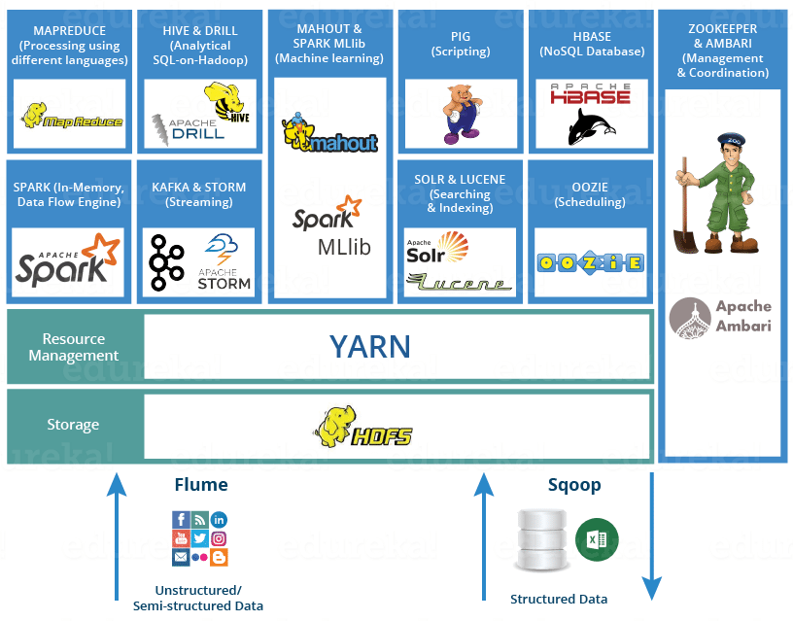
Hadoop Ecosystem

Slide 6
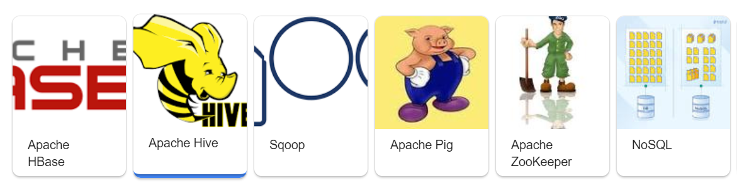
Essential Hadoop Tools
Hadoop Tools are useful for data input, high-level processing, workflow management, creation of huge databases.
Pig – scripting tool to examine data locally and on Hadoop cluster. It’s a high-level language to write complex MapReduce transformations.
Hive-The Apache Hive data warehouse software facilitates querying and managing large datasets residing in distributed storage
Sqoop-Sqoop is a tool designed to transfer data between Hadoop and relational databases (MySQL<-> HDFS)
Flume-capture weblog data into HDFS
Oozie-run Hadoop workflows
Hbase- a database that is used to store and access data on a Hadoop cluster

Slide 7

Apache Pig
It is a HLL – Pig Latin (SQL like query Language)
PIG is a data flow language; the key focus of Pig is manage the flow of data from input source to output store.
As part of managing this data flow it moves data feeding it to process1, taking output and feeding it to process2.
Defines a set of transformations on a data set
Aggregate, join, and sort
Also used for ETL
Usage modes – local and non-local (cluster)
Interactive mode and Batch mode.

Slide 8
Pig Execution Modes
/* local mode */
$ pig -x local ...
/* Tez local mode */
$ pig -x tez_local ...
/* Spark local mode */
$ pig -x spark_local ...
/* mapreduce mode */
$ pig ...
or
$ pig -x mapreduce ...
/* Tez mode */
$ pig -x tez ...
/* Spark mode */
$ pig -x spark ...

Slide 9
Pig Statements
Pig Latin statements are generally organized as follows:
A LOAD statement to read data from the file system.
A series of "transformation" statements to process the data.
A DUMP statement to view results or a STORE statement to save the results.

Slide 10
Pig Example
Extract usernames from the passwd file.
/etc/passwd
$cp /etc/passwd create a copy
$hdfs dfs –put passwd passwd put it in Hadoop
$hdfs dfs –ls passwd confirm
$pig –x local Local Pig operation
grunt> A = load ‘passwd’ using PigStorage(‘:’);
grunt> B = foreach A generate $0 as id;
grunt> dump B; display the results
grunt> quit;
$pig –x mapreduce

Slide 11

Apache Hive
Apache Hive is a data warehouse built on top of Hadoop
Summarization, ad hoc queries, analysis of big data .
It stores schema in a database and processed data into HDFS.
It is designed for OLAP. Hive is not designed for online transaction processing (OLTP) workloads.
It provides SQL type language for querying called HiveQL or HQL.
It is familiar, fast, scalable, and extensible.

Slide 12
Creating Tables
CREATE TABLE page_view(
viewTime INT,
userid BIGINT,
page_url STRING,
referrer_url STRING,
ip STRING COMMENT 'IP Address of the
User')
COMMENT 'This is the page view table'
PARTITIONED BY(dt STRING, country STRING)
STORED AS SEQUENCEFILE;

Slide 13
Query the Table
SELECT user.*
FROM user
WHERE user.active = 1;

Slide 14
Example
$hive start hive
hive> hive prompt
$CREATE TABLE pokes; create table
$SHOW TABLES; Displays the tables
$DROP TABL pokes; deletes pokes table
$CREATE TABLE logs(t1 string, t2 string, t3 string, t4 string, t5 string, t6 string, t7 string) ROW FORMAT DELIMITED FIELDS TERMINATED BY ‘ ‘;
Load the data from example.log
hive> LOAD DATA LOCAL INPATH ‘sample.log’ OVERWRITE INTO TABLE logs;

Slide 15
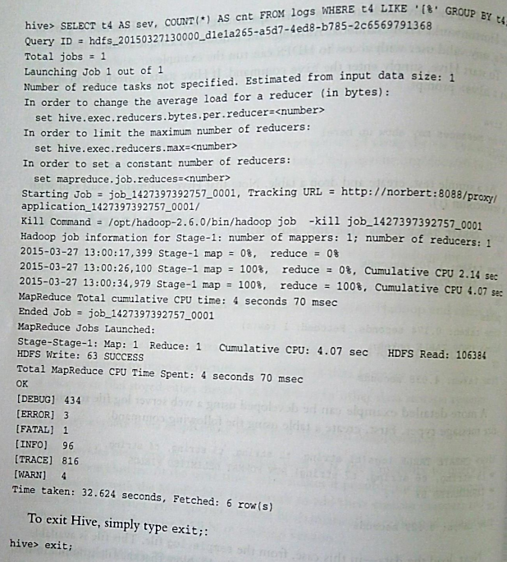

Slide 16

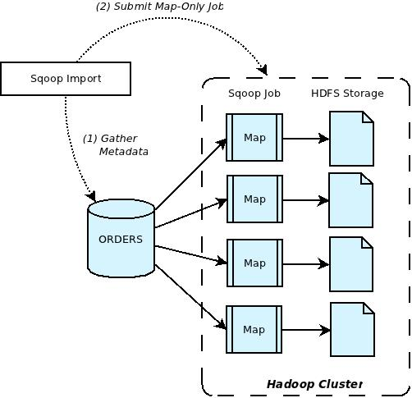
Apache Sqoop
Used to transfer data between Hadoop and DB Tables.
Import data from RDBMS to HDFS
The import tool imports individual tables from RDBMS to HDFS. Each row in a table is treated as a record in HDFS.
IMPORT
Step 1: Example database to gather metadata
Step-2: Map only and submits to cluster

Slide 17
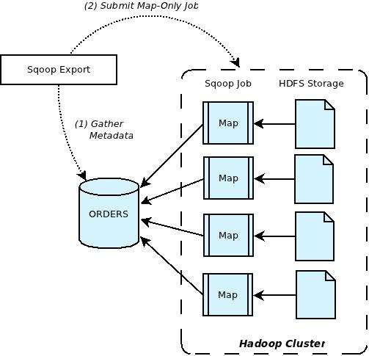
Data Export
Step-1: Examine database for metadata
Step-2: Map only Hadoop job into database.

Slide 18

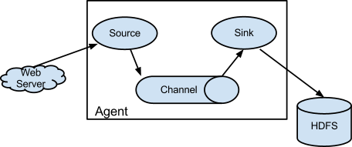
Apache Flume
Used to collect, transport, and store data into HDFS.
This is often used for log files, social media generated data, email messages, traffic data, etc.
Components of Flume: Source, Channel, and Sink

Slide 19
Flume…
Source; Receives data and send it to channel (more channels is possible)
Channel: Data queue that forwards the source data to sink (like a buffer).
Sink: Delivers data (commits permanently) to HDFS, local file, etc.

Slide 20
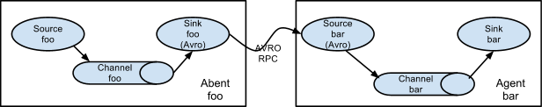
Pipelined Flume Agents
Avro – data format (JSON)

Slide 21
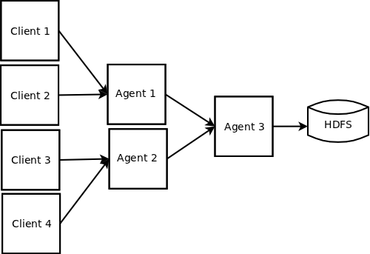
Converging flow on Flume

Slide 22
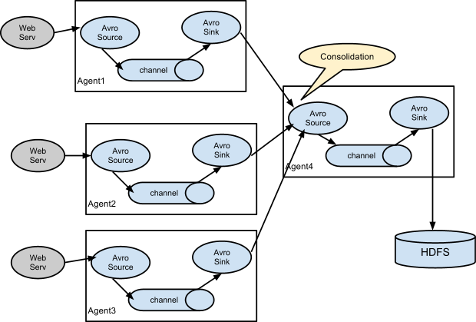
Flume Consolidation N/W

Slide 23
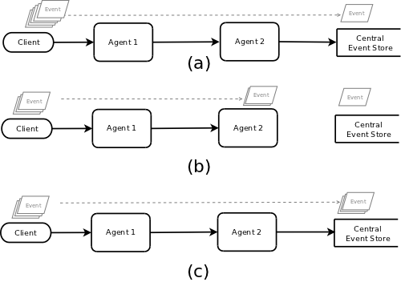
Handling Failures
When a flow that passes through many different agents encounters a communication failure on any leg of the flow, the affected events start getting buffered at the last unaffected agent in the flow.
If the failure is not resolved on time, this may lead to the failure of the last unaffected agent, which then would force the agent before it to start buffering the events.
Eventually if the failure occurs when the client transmits the event to its first-hop destination, the failure will be reported back to the client which can then allow the application generating the events to take appropriate action.
the flow is normal
communication failure occurs between Agent 2 and the event store resulting in events being buffered on Agent 2.
the cause of failure was addressed and the flow was restored

Slide 24

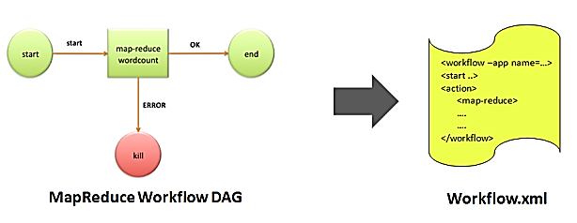
Apache Oozie
Apache Oozie is a workflow scheduler for Hadoop.
It is a system which runs the workflow of dependent jobs.
Here, users are permitted to create Directed Acyclic Graphs of workflows, which can be run in parallel and sequentially in Hadoop.

Slide 25
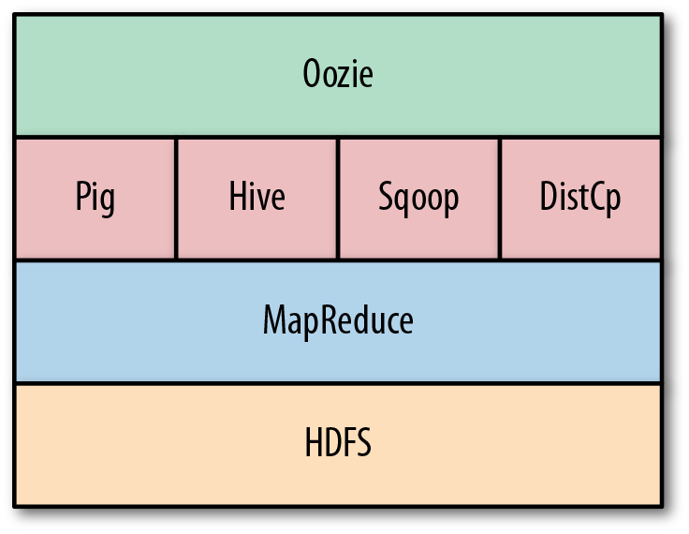
Oozie

Slide 26
Oozie Job Types
Oozie is integrated with the rest of the Hadoop stack supporting several types of Hadoop jobs
Java map-reduce, Streaming map-reduce, Pig, Hive, Sqoop and Distcp
Workflow
A specified sequence of Hadoop jobs with outcome based decision points and control dependency (DAG).
Coordinator
A scheduled workflow job that can run at various time intervals or when data is available.
Bundle
Oozie abstraction that will batch a set of coordinator jobs.

Slide 27
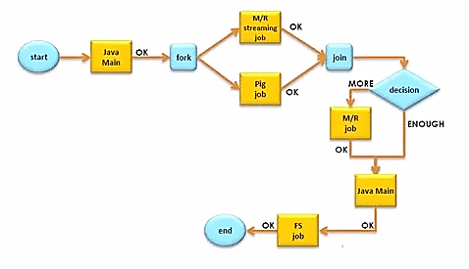
Node Types
Control Flow Node: These nodes are responsible for defining start, end, and control flow of what to do inside the Workflow.
Action Node: Actual processing.
Fork/Join Node: Parallel execution of tasks.

Slide 28

Apache HBase
Apache HBase is an open-source, distributed, versioned, non-relational database (NoSQL) modeled after Google's Bigtable (A Distributed Storage System for Structured Data)
Features:
Linear and Modular capability
Consistent read and write
Automatic and configurable sharding (small part) of tables
Automatic failover support
Base classes for backing
Easy to use Java APIs
Is a Column-oriented datastore

Slide 29
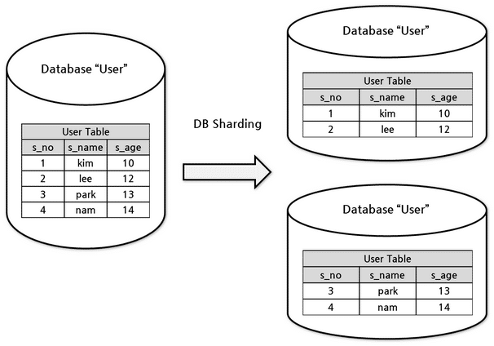
Example - Sharding

Slide 30
Example – Flight Analytics
A jet engine generates various types of data from different sensors like pressure sensor, temperature sensor, speed sensor, etc. which indicates the health of the engine.
This is very useful to understand the problems and status of the flight.
Continuous Engine Operations generates 500 GB data per flight and there are 300 thousand flights per day approximately.
So, Engine Analytics applied to such data in near real time can be used to proactively diagnose problems and reduce unplanned downtime.
This requires a distributed environment to store large amount of data with fast random reads and writes for real time processing

Slide 31
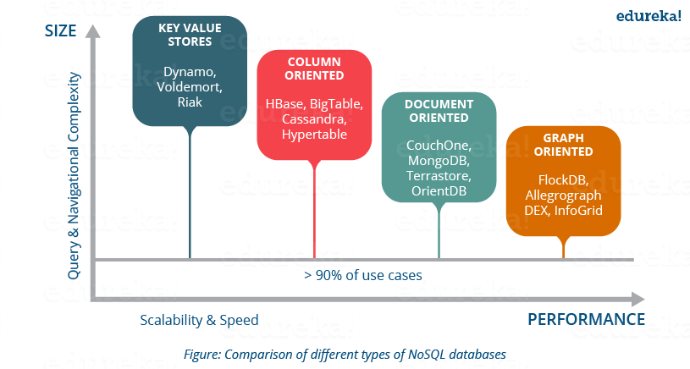
NoSQL Databases

Slide 32
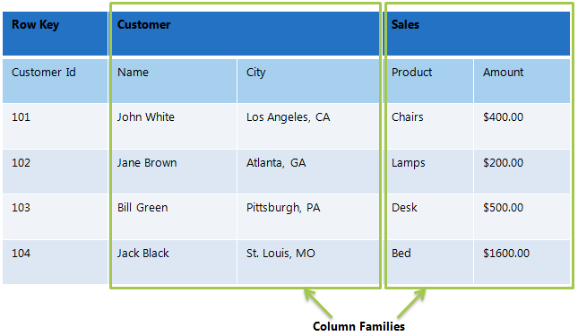
HBase Data Model
Table in HBase is same as other DBMS
The Data Model in HBase is made of different logical components such as Tables, Rows, Column Families, Columns, Cells and Versions (timestamp).
Columns in HBase are grouped into families, all with the same prefix.

Slide 33

Case Study - Messenger
Facebook faced challenges in storing, accessing, and processing huge data coming from billions of Facebook users
Facebook Messenger combines Messages, email, chat and SMS into a real-time conversation.
Facebook was trying to build a scalable and robust infrastructure to handle set of these services.
At that time the message infrastructure handled over 350 million users sending over 15 billion person-to-person messages per month.
The chat service supports over 300 million users who send over 120 billion messages per month.
They tried MySQL, Cassandra, and Hbase*.

Slide 34
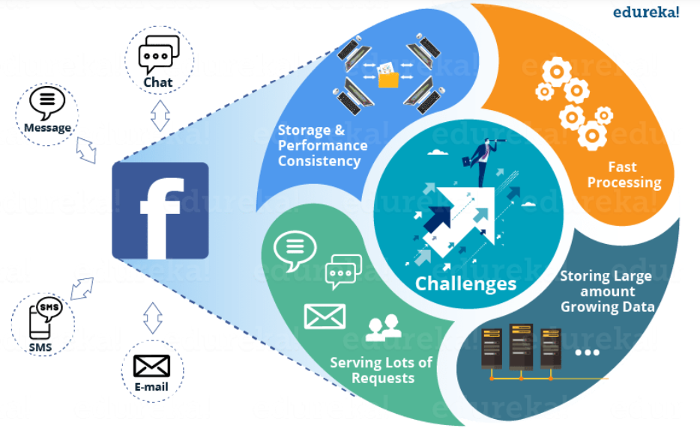
Challenges

Slide 35
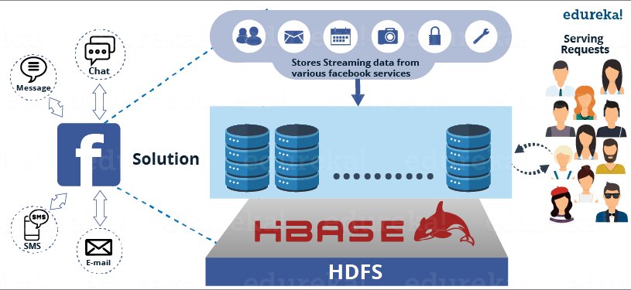
Hbase Solution

Slide 36
Hadoop YARN Applications

Slide 37
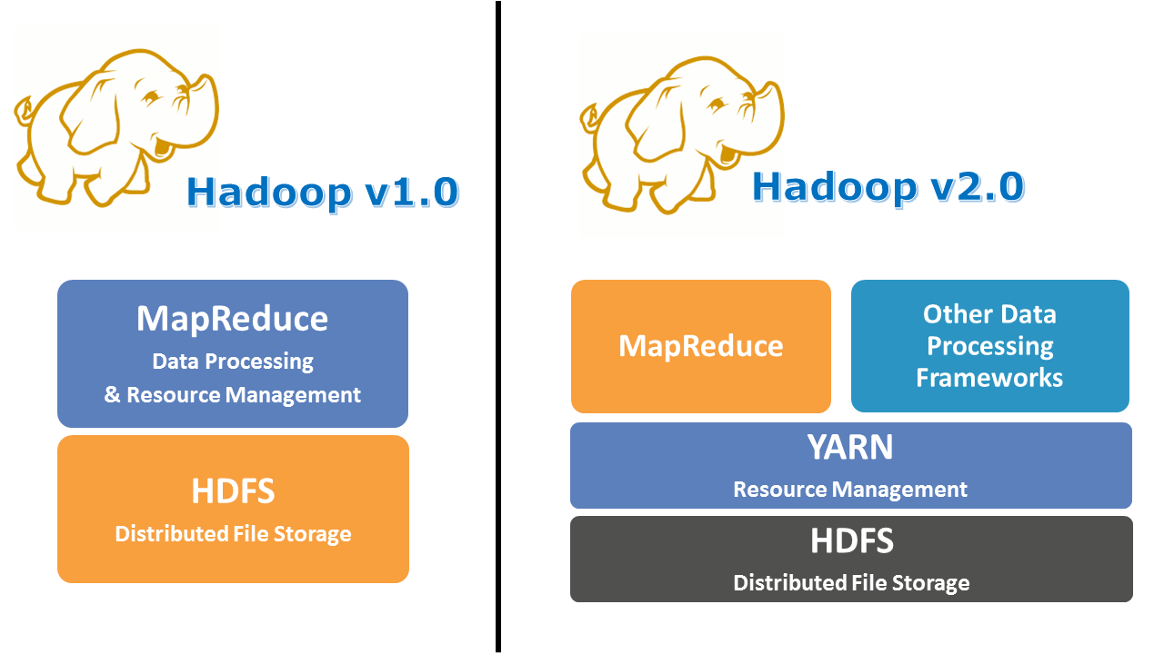
Why YARN (Yet Another Resource Negotiator)?

Slide 38
Introduction
In Hadoop version 1.0 which is also referred to as MRV1(MapReduce Version 1), MapReduce performed both processing and resource management functions.
This design resulted in scalability bottleneck due to a single Job Tracker.
To overcome all these issues, YARN was introduced in Hadoop version 2.0 in the year 2012 by Yahoo and Hortonworks.
The basic idea behind YARN is to relieve MapReduce by taking over the responsibility of Resource Management and Job Scheduling.
YARN started to give Hadoop the ability to run non-MapReduce jobs within the Hadoop framework.

Slide 39
YARN Distributed Shell
Hadoop YARN project includes the Distributed-Shell application, which is an example of a non-MapReduce application built on top of YARN.
Distributed-Shell is a simple mechanism for running shell commands and scripts in containers on multiple nodes in a Hadoop cluster.
There are multiple existing implementations of a distributed shell that administrators typically use to manage a cluster of machines. So this application is a way to demonstrate how such a utility can be implemented on top of YARN.
More than just providing a parallel execution application, Distributed-Shell can be used as a starting point for exploring and building Hadoop YARN applications.

Slide 40
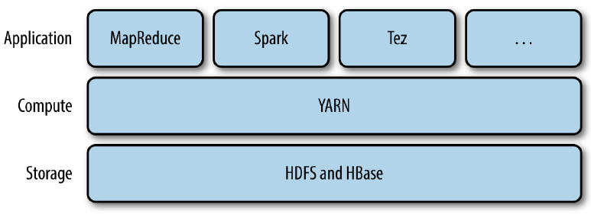
Structure of YARN Applications
YARN provides APIs for requesting and working with cluster resources, but these APIs are not typically used directly by user code.
Instead, users write to higher-level APIs provided by distributed computing frameworks, which themselves are built on YARN and hide the resource management details from the user.

Slide 41
YARN Application Framework
YARN provides its core services via two types of long-running daemon:
a resource manager (one per cluster) to manage the use of resources across the cluster,
a node managers running on all the nodes in the cluster to launch and monitor containers
A container executes an application-specific process with a constrained set of resources (memory, CPU, and so on).

Slide 42
How YARN runs an application
1. Client contacts the resource manager and asks it to run an application master process
2a,2b The resource manager then finds a node manager that can launch the application master in a container
3. Can request more containers from the resource managers, and use them to run a distributed computation

Slide 43
Apache Tez
Apache Tez represents an alternative to the traditional MapReduce that allows for jobs to meet demands for fast response times and extreme throughput at petabyte scale.
Tez generalizes the MapReduce paradigm to a more powerful framework based on expressing computations as a dataflow graph.
Tez is not meant directly for end-users – in fact it enables developers to build end-user applications with much better performance and flexibility.
Data Processing API in Apache Tez describes a simple Java API used to express a DAG of data processing. The API has three components:
DAG. this defines the overall job. The user creates a DAG object for each data processing job.
Vertex. this defines the user logic and the resources & environment needed to execute the user logic. The user creates a Vertex object for each step in the job and adds it to the DAG.
Edge. this defines the connection between producer and consumer vertices. The user creates an Edge object and connects the producer and consumer vertices using it.

Slide 44

Apache Giraph
Apache Giraph is an Apache project to perform graph processing on big data. Giraph utilizes Apache Hadoop's MapReduce implementation to process graphs.
Facebook used Giraph with some performance improvements to analyze one trillion edges using 200 machines in 4 minutes.

Slide 45
Hoya: HBase on YARN
Hoya is basically running HBase on YARN
Hoya creates HBase clusters on top of YARN.
It does this with a client application called Hoya client; this application creates the persistent configuration files, sets up the HBase cluster XML files, and then asks YARN to create an ApplicationMaster, which is the Hoya AM here.

Slide 46
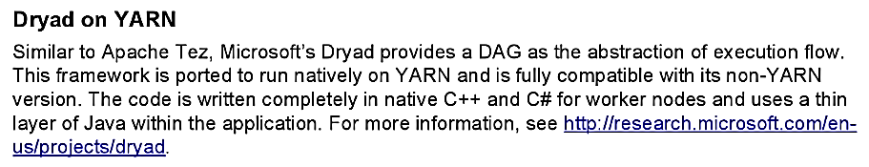
Dryad on YARN
https://www.microsoft.com/en-us/research/project/dryad/

Slide 47
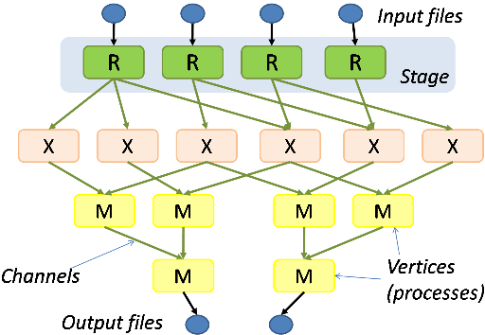
Dryad
Dryad is an infrastructure which allows a programmer to use the resources of a computer cluster or a data center for running data-parallel programs.
A Dryad programmer can use thousands of machines, each of them with multiple processors or cores, without knowing anything about concurrent programming.

Slide 48
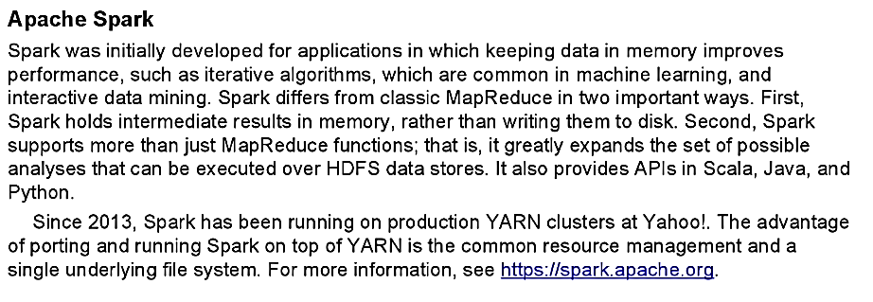
Apache Spark

Slide 49
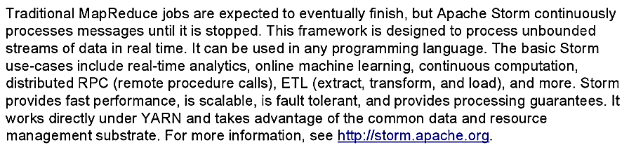
Apache Storm

Slide 50
Why use Apache Storm?
Apache Storm is a free and open source distributed realtime computation system.
Apache Storm makes it easy to reliably process unbounded streams of data, doing for realtime processing what Hadoop did for batch processing.
Apache Storm is simple, can be used with any programming language, and is a lot of fun to use!
There are two kinds of nodes on a Storm cluster: the master node and the worker nodes.
The master node runs a daemon called "Nimbus" that is similar to Hadoop's "JobTracker".
Nimbus is responsible for distributing code around the cluster, assigning tasks to machines, and monitoring for failures.

Slide 51
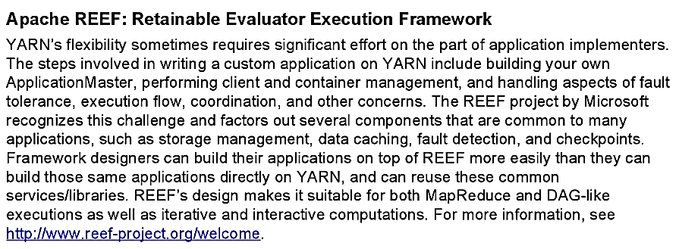
Apache REEF: Retainable Evaluator Execution Framework

Slide 52
REEF components
Map-Reduce runtime components:
Driver: captures the client code embodying the scheduler
Evaluator: provides a runtime environment on a container.
Task: encapsulates the task-level client code to be executed in an Evaluator.

Slide 53
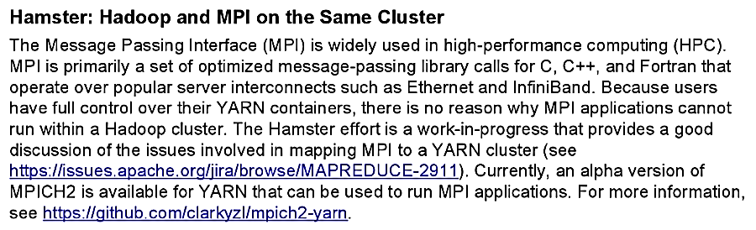
Hamster: Hadoop and MPI on the Same Cluster

Slide 54
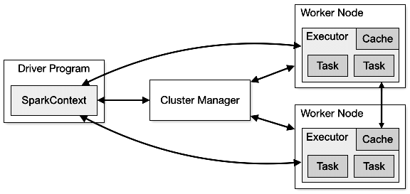
Hamster

Slide 55
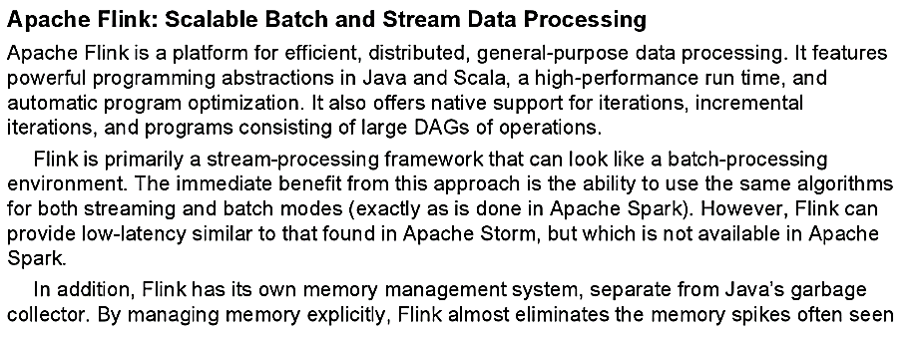
Apache Flink: Scalable Batch and Stream Data Processing

Slide 56
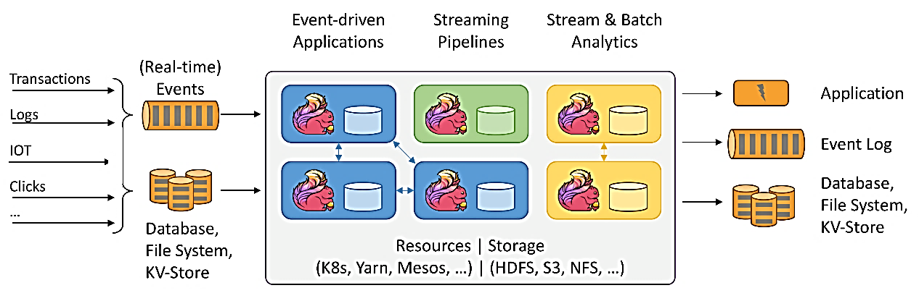
Flink
Apache Flink is an open-source stream-processing framework developed by the Apache Software Foundation.
Apache Flink is a framework and distributed processing engine for stateful computations over unbounded (start and no end) and bounded (start & end) data streams.
Flink has been designed to run in all common cluster environments, perform computations at in-memory speed and at any scale

Slide 57
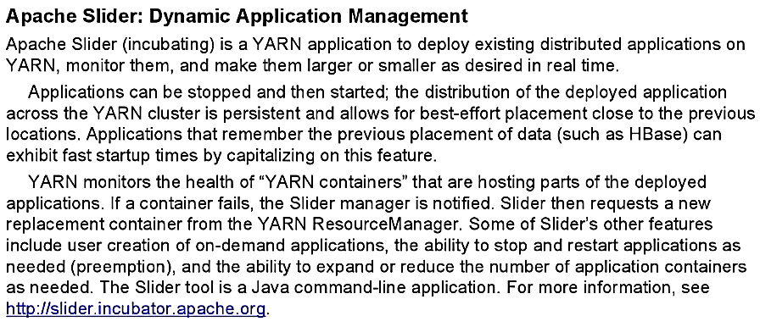
Apache Slider: Dynamic Application Management

Slide 58
Slider
Slider is a framework for deployment and management of these long-running data access applications in Hadoop.
Slider leverages YARN’s resource management capabilities to deploy those applications, to manage their lifecycles and scale them up or down–even while the application is running. Slider “slides” existing long-running services (like Apache HBase, Apache Accumulo and Apache Storm) onto YARN, so that they have enough resources to handle changing amounts of data, without tying up more processing resources than they need.
Apache Slider allows users to create and run different versions of heterogeneous long-running applications in Hadoop with YARN. Each application instance can be configured differently, with its operational life cycle managed individually. On an on-demand basis, Slider can expand or shrink application instances while they are running. In the case of container failure, Slider transparently leverages YARN facilities to manage application recovery. All of this is available on Linux or Windows platforms.

Slide 59
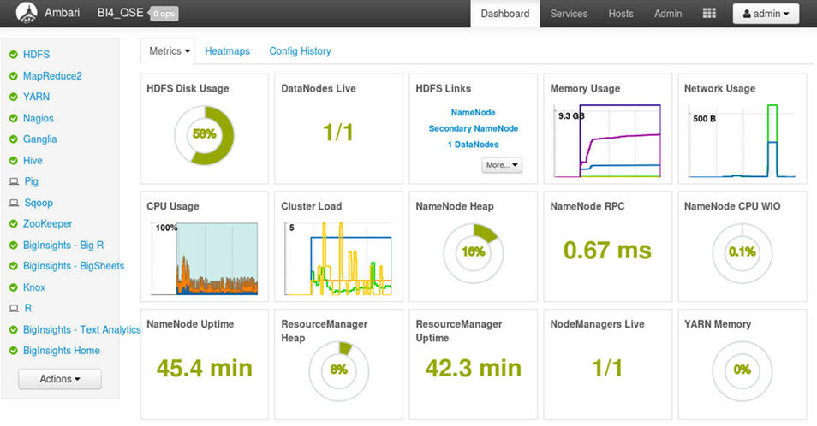
Apache Ambari Dashboard
https://intellipaat.com/blog/what-is-apache-ambari/

Slide 60
Summary

